Slide 1
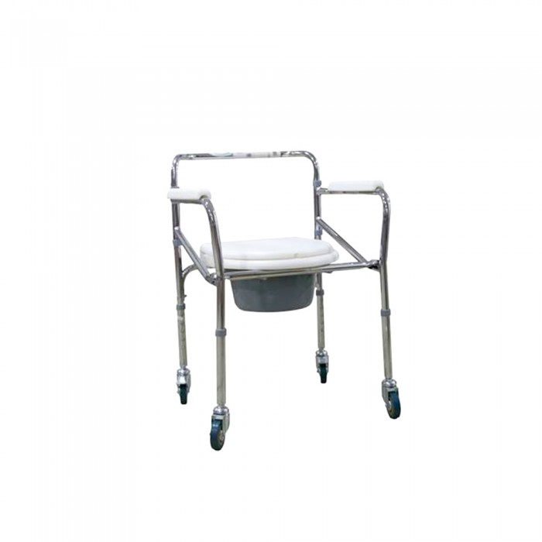
Bathroom wheelchair - FS 696
245.00 R.S
Chrome-plated steel frame, fixed armrest, solid rear wheel with lock, plastic seat. Each wheelchair can be pushed either by the user or the attendant and height adjustable by the use of push buttons on the legs.

Slide 2
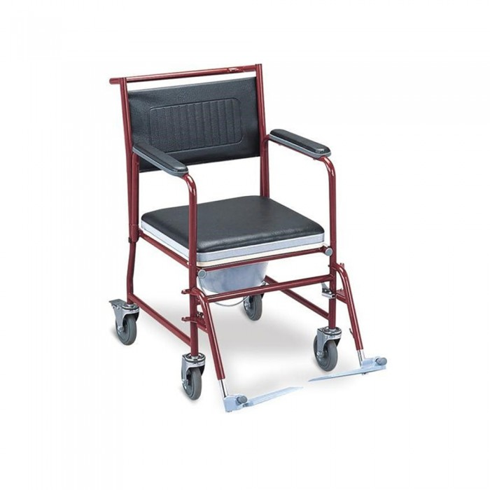
Bathroom wheelchair - FS 691
325.00 R.S
Steel Wheelchair (FS 691) is a folding powder coated steel frame with an openable armrest and a detachable footrest.It has a soft Flint seat and lockable wheel brake.The padded seat and armrests provide maximum comfort and stability to the user.

Slide 3
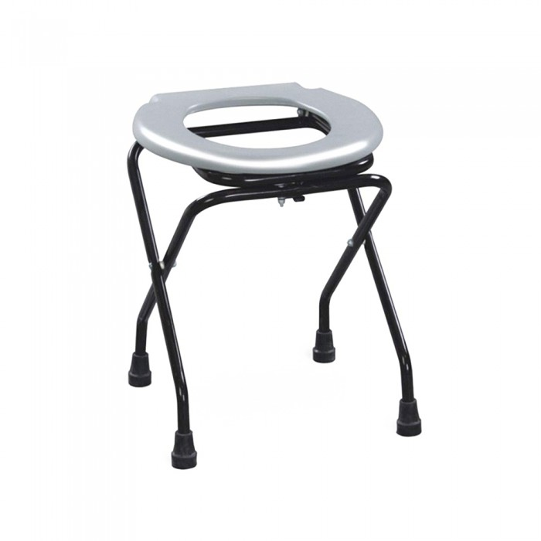
Bath chair without stand-FS-897
75.00 R.S
Convenient and hygienic solution, foldable and portable design , it is a clean, compact and lightweight device that can be used for a long period of time and is made of high-quality materials and durability

Slide 4
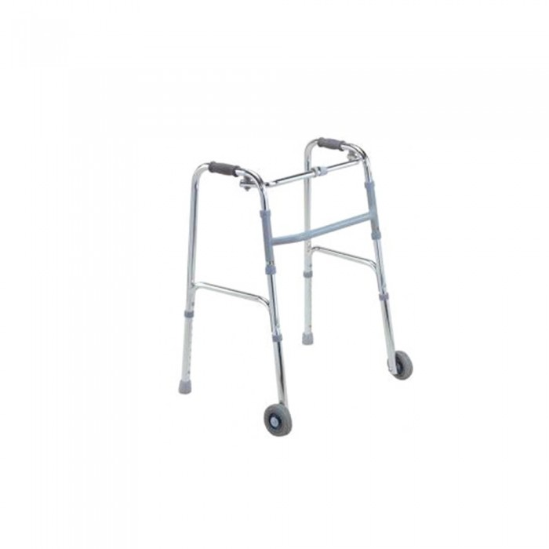
Aluminum medical Walker with wheels-KJT-912.
165.00 R.S
- Mobile walker to support walking for those who have difficulty moving .. The walker can move right and left as foot steps without lifting it can also be folded and spread and also can adjust its height according to the appropriate length.

Slide 5

Dimcare innovative bath towel
34.50 R.S
Method of use :- Step: use foam sheets to wipe all over the body.- Step Two: remove bubbles and dirt with a cleaning paper

Slide 6
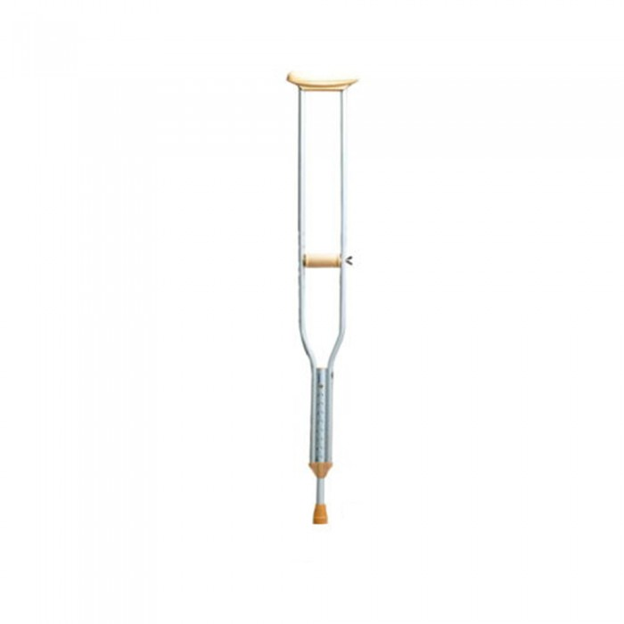
Large underarm aluminum walking stick - 925
80.00 R.S
- Underarm crutch, adjustable height - 5-file adjustable handle, suitable for different people using arm length.- Solid base, good support, high stability.- It can withstand 100kg weight with high quality and sustainability .

